Slide 1

ECEN 404 Final Presentation
Team 56: Fall Detection Nhan Nguyen, Justin Haryanto
Sponsor: Krishna Gadepally TA: Swarnabha Roy, Dalton W. Cyr
Notes:
Michelle

Slide 2
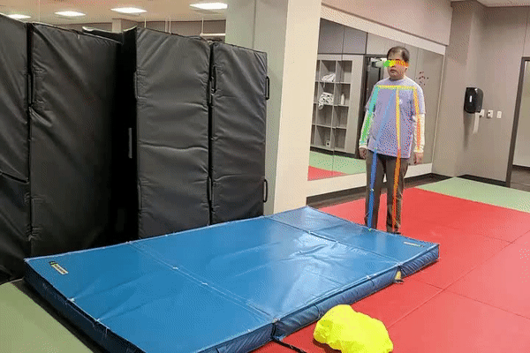
Project Overview
Problem
Design a video-based fall detection system
Solution
Convert video and images in to a useable format
Determine if a fall has occurred using Random Forests and CNN machine learning models
Output result as a video to user
Notes:
30 seconds

Slide 3
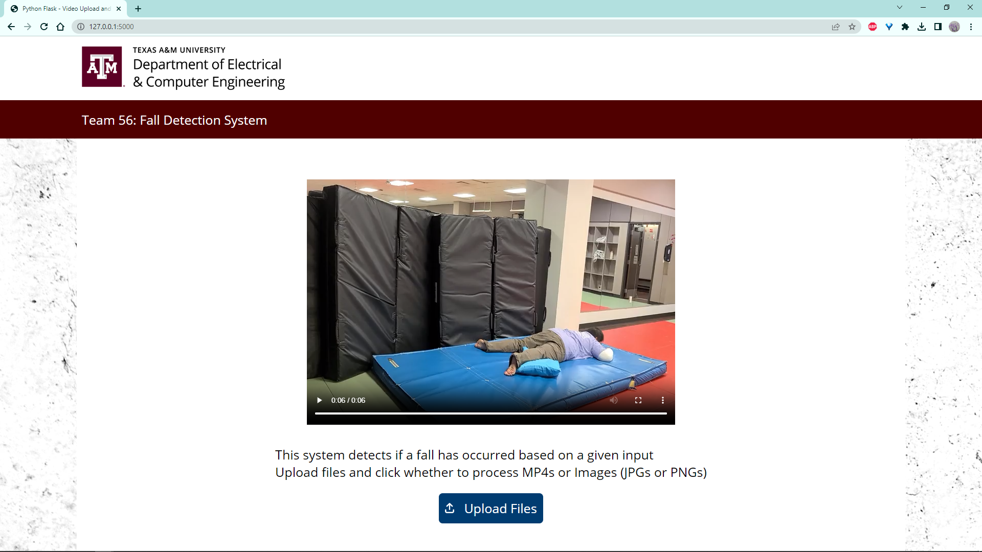
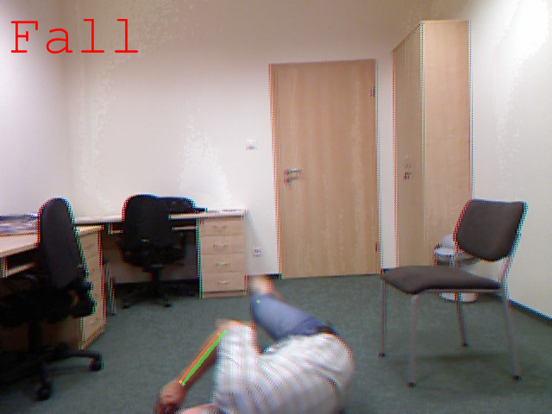
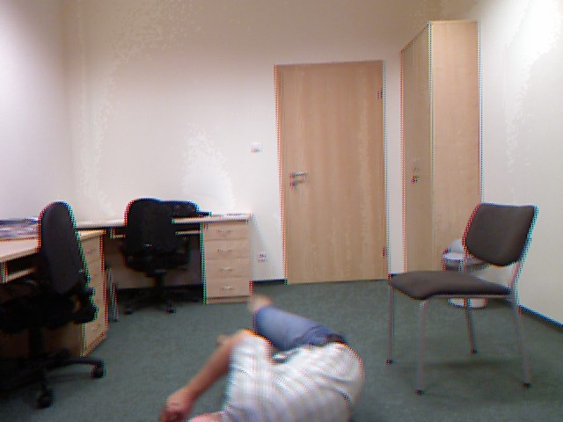
Integrated Project Diagram
Website UI
Upload File
Post Result
Google Colab
User
Send File
Pose Estimation
Upload Result
Send Processed Data
Fall Detection

Slide 5
Nhan Nguyen
Trained and tested the Random Forests and CNN machine learning models for use in the fall detection system
Developed code to process images and pair them with numerical results (like keypoints and bounding boxes) from AlphaPose for fall detection training
Modified detection models to gauge and improve accuracy
Integrate AlphaPose with Fall Detection subsystem
Integrate the UI with the rest of the subsystems alongside Justin

Slide 6
Nhan Nguyen
Challenges
Relatively low accuracies for ML models
Difficulties with RAM usage during ML models training
Difficulties in integrating AlphaPose-Fall Detection system and UI due to unexpected issues with interfacing with UI website
Solution
Adjust the architecture of ML models and more training to increase accuracy
Found a higher RAM environment for training and work out techniques to reduce RAM usage
Careful troubleshooting of UI code and starting back from the original state of the UI code

Slide 7
Nhan Nguyen
Validation Plan
>90% accuracy of random forest
>90% accuracy of CNN
>90% accuracy of fall detection system
Validation Status
92% accuracy of random forest on all testing sets
35% accuracy of CNN on all testing sets
 | UR Dataset | Adhikari Dataset | Both
RF | 0.96 | 0.92 | 0.92
CNN | 0.67 | 0.17 | 0.35

Slide 8
Justin Haryanto
Prepared over 40 fall detection datasets, each ranging from 100 to 4000 images, by adding keypoint and bounding boxes to a csv, allowing for model training
Recorded more than 70 video clips of myself falling and not falling onto Judo mats for testing the fall detection models
Designed the GUI for the system, modeled after A&M websites
Hosted the GUI on a website using Flask and Ngrok, allowing the user to interact with the system from anywhere
Developed code to allow the system to accept and process both video and images, as well error checking to ensure the correct files are given
Integrated the fall detection system to the UI with Nhan

Slide 9
Justin Haryanto
Challenges
Finding a UI solution that works with Google Colabs
Figuring out ways to send files without the use of Google Drive
Solution
A combination of Flask (to design the website) and NGrok (to host it) solved both solutions
The models can be kept on Colab, allowing for the utilization of Google’s processing resources
Allowed for files to be uploaded directly to Colab

Slide 10
Justin Haryanto
Validation Plan
>15 UR and >5 Adhikari fall datasets
>10 480p MP4 clips of with a max duration of 10 seconds
Create a UI for the user to upload an MP4 or series of images and display the result to the user as a video
Validation Status
30 UR and 10 Adhikari fall datasets
78 MP4 clips with a duration of 5 to 7 seconds
Designed a website, based on a typical A&M website, that allowed for file upload and error checking

Slide 11
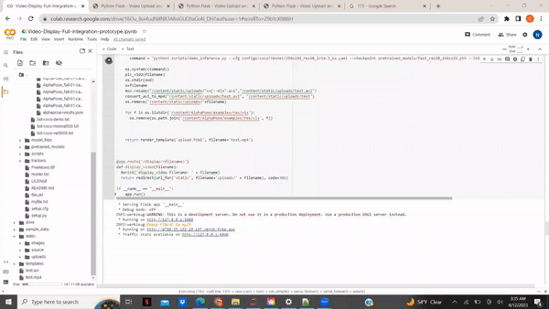
Integrated System Results
System could accept either a single video or series of images, not both at once
System will display an error message if above requirements are violated
System takes at least 1 minute to process input

Slide 12
Conclusion
Issues
Improvements on the pose estimation subsystem was limited and above the expertise of the team
New features were being added and an unclear end goal resulted in scope creep
Full system integration was not ready at the start of the semester

Slide 13
Conclusion
Changes from Original Plan
Pose Estimation subsystem improvements put aside
Nhan was better suited at ML models so took over the fall detection subsystem
The externals subsystem was added (involving datasets for training and testing, as well as the UI) and worked by Justin
Live video feed was determined to be an optional feature
Current Status
Integration is complete
Accuracy of the full system is not fully validated and further stress testing of the system is likely needed
Adding UI scaling for different screen sizes (such as phones)

Slide 14
Thank You
Notes:
30 seconds

